Slide 1
2018 Asphalt Summits
Todd W. Whittington, PE – State Field Operations Manager
Materials and Tests Unit

Slide 2

2018 QMS Manual Updates
From the Table of Contents…
MAJOR CHANGES FOR QMS MANUAL
Section 1: | Quality Management System (QMS) for Asphalt Pavements
Page No. | Subsection | Change
1-4 | 1.3.6 | Updated reference to M&T Website for verifying Technician Certification.
Various | Various | Changed references from “QA Supervisor” to “Pavement Specialist”.
Various | Various | Changed references from “Asphalt Design Engineer” to “Engineer”.
Various | Various | Changed references from “QA Lab Supervisor” to “M&T Regional Lab Supervisor”.
Section 2: | Materials Used In Asphalt Paving
Page No. | Subsection | Change
2-10 | Table 1012-1 | Updated Table based on New Mix Types.
2-12 | Notes | Updated “Notes for Table 1005-1” to match 2018 Specifications.
Various | Various | Changed references from “QA Supervisor” to “Pavement Specialist”.
Section 3: | Asphalt Pavement Design
Page No. | Subsection | Change
3-3 | Figure 3-3 | Updated Table based on New Mix Types.
3-3 | 3.3 | Updated Table based on New Mix Types.
3-4 | 3.3 | Updated Table based on New Mix Types.
3-5 | 3.4 | Updated Table based on New Mix Types.
Section 4: | Asphalt Mix Design and Job Mix Formulas
Page No. | Subsection | Change
4-4 | 4.4.2 | Removed outdated references to changes in PG grade.
4-5 | 4.4.4 | Cited Table 610-3 for Dust/Binder Ratio requirements.
4-5 | 4.4.6 | Removed Mix Types SF9.5A, S12.5C & S12.5D.
4-6 | 4.5 | Included 20 day approval time for OGFC & UWBC mixes.
4-6 | 4.5 | Updated reference to Asphalt Institute Mix Design manual.
4-7 | 4.5 | Removed Mix Types SF9.5A, S12.5C & S12.5D.
4-8 | Table 610-2 | Updated Table based on New Mix Types.
4-9 | Table 610-3 | Updated Table based on New Mix Types.
4-9 | 4.6 | Added new Tables 610-4 & 610-5 to match 2018 Specifications.
4-10 | 4.8 | Added updated text detailing Recycled requirements to match 2018 Specifications.
4-12 | 4.9.1 | Updated Table based on New Mix Types.
Various | Various | Changed references from “QA Supervisor” to “Pavement Specialist”.
Section 5: | Asphalt Plant Equipment
Page No. | Subsection | Change
5-7 | 5.7 | Added language for requirements for Anti-Strip meters to match 2018 Specifications.
5-7 | 5.7 | Transferred requirements for Hydrated Lime from Specifications book.
Various | Various | Changed references from “QA Supervisor” to “Pavement Specialist”.
Section 6: | Asphalt Plant Operations
Page No. | Subsection | Change
6-1 | 6.1.2 | Updated Table based on New Mix Types.
6-22 | 6.9 | Added specific reference to 610-7 and Section 9.5.1 concerning hauling mix.
6-22 | 6.9 | Updated reference to M&T Website for verifying Approved Truck Release Agents.
6-22 | 6.9 | Removed Figure 6-20 showing old style Dial thermometer.
Various | Various | Changed references from “QA Supervisor” to “Pavement Specialist”.

Slide 3
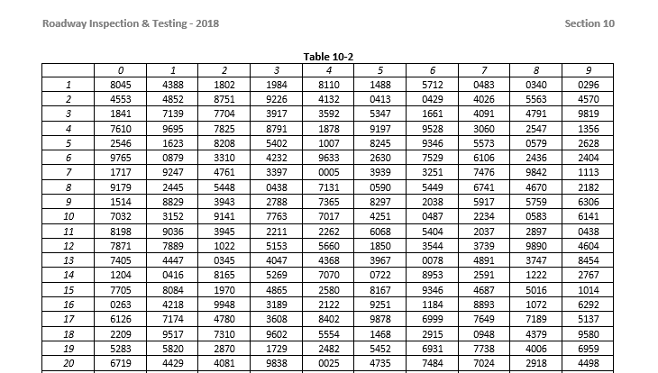
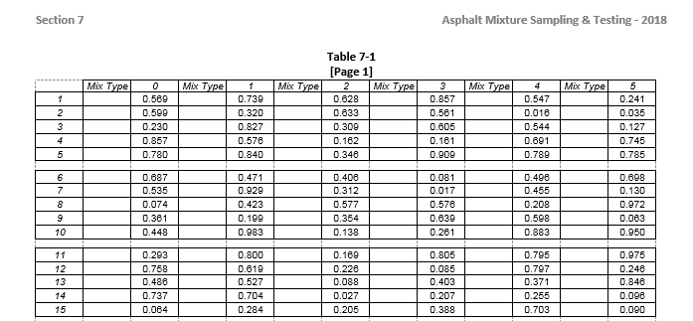
Random Number Tables
2018 QMS Manual Updates
Both Tables Updated for 2018:

Slide 4
JMF Changes
2018 QMS Manual Updates
Previously
Changes Allowed by QC
  (Notify QA Supervisor)
Changes Approved by QA Supervisor
Changes Approved by Pavement Specialist
Changes Approved by Mix Design Engineer
Current
Changes Allowed by QC
  (Notify Pavement Specialist)
Changes Approved by Pavement Specialist
Changes Approved by Mix Design Engineer

Slide 5
Recycle Limits – “Recycled Binder Replacement”
2018 QMS Manual Updates

Slide 6
Updated Placement Temperatures
2018 QMS Manual Updates

Slide 7
Checking Truck Temperatures
2018 QMS Manual Updates
JMF Mix Temperature is chosen by the contractor.
Set when the JMF is approved or modified.

Slide 8
Checking Truck Temperatures
2018 QMS Manual Updates
Example on Page 10-6:

Slide 9
Checking Truck Temperatures
2018 QMS Manual Updates
Calibrated Digital or Dial Stem Thermometer
  (with a probe length of 10” or greater)
Within ± 25°F of the Temperature Specified on JMF
  If Outside of the range, take a minimum of 3 additional readings should be made in different points of the load.
  The 4 readings are then averaged and the average used as the temperature of that load.
  Note: Mix shall not be rejected based on the reading of a Dial Stem thermometer.

Slide 10
Updated Minimum Density Table
2018 QMS Manual Updates

Slide 11
10.4.3: Density Gauge Control Strips
2018 QMS Manual Updates
A Control Strip shall be placed within the first density gauge test section.
A minimum of once every 14 calendar days for each contract, unless otherwise approved by the Engineer.
  A control strip placed for any of the below listed reasons will suffice for this 14 calendar day requirement.
Control strips shall be placed anytime one or more of the following JMF changes are made:
  Any percentage change in total binder content
  An aggregate blend change in excess of 10%
  Any change in the G_{mb} or G_{mm} on the JMF
Control strips shall be placed for each layer of mix.
Control strips shall be placed anytime the underlying surface changes significantly.
Control strips shall be placed for different layer thickness of the same mix type when the specified thickness varies by more than ± 1/2 inch.
Control strips shall be placed anytime the Contractor is proceeding on limited production due to failing densities.
Control strips shall be placed anytime a new, re-calibrated, or different density gauge is used.
Control strips shall be placed when different plants are being used.
The Engineer may require control strips anytime, as deemed necessary.

Slide 12
QMS Manual -- Figure 3-3
Mix Consolidation

Slide 13
QMS Manual -- Figure 3-3
Mix Consolidation

Slide 14
Table 610-3: Mix Types
Mix Consolidation

Slide 15
NEW Table 610-3: “Consolidated”
Mix Consolidation

Slide 16
OGFC Mix Changes
Asphalt Summits

Slide 17
OGFC Mix Changes - FC-1 Modified
Asphalt Summits
Travel Lane (mainline) = Minimum 3/4” compacted depth
  Ensures the desired level of permeability within the mix and the drainage of water from the surface.
Acceleration/Deceleration lanes, Gore areas, and other transition areas = Minimum 5/8” compacted depth
OGFC @ Bridges
  Do NOT Trench -- Do NOT Mill
  Taper Down the mix (start approx. 50’ from Approach)

Slide 18
OGFC Mix Changes - FC-1 Modified
Asphalt Summits
 | Travel Lane Pavement | Acceleration Lanes, Deceleration Lanes, Gore Areas, Transitions, etc.
2012 Specifications | FC-2 Modified | FC-1 Modified
 | approx. 3/4” (90 lbs./sq. yd.) | approx. 5/8” (70 lbs./sq. yd.)
2018 Specifications | FC-1 Modified | FC-1 Modified
 | approx. 3/4” (90 lbs./sq. yd.) | approx. 5/8” (70 lbs./sq. yd.)

Slide 19
10.7.1: Core Sample Test Section Procedures
Asphalt Summits
Verification Cores
  Taken in the presence of a DOT technician.
  Delivered directly to M&T Lab by a DOT technician
    3-day Turnaround Time
  OR
  Delivered to the Contractor’s QC Lab for pickup by M&T personnel.
    Place inside a six (6) inch diameter tin or plastic cylinder and then into a cloth sample bag.
    The sample bag should then be sealed with a metal tag.

Slide 20
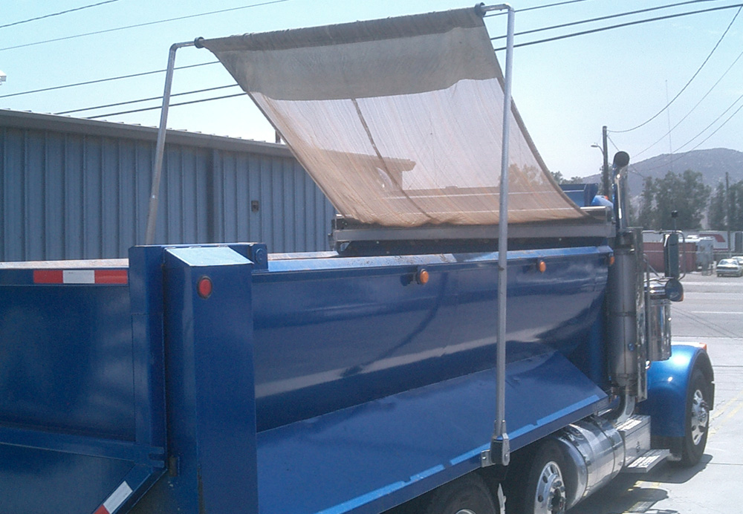
Truck Tarps
Asphalt Summits

Slide 21
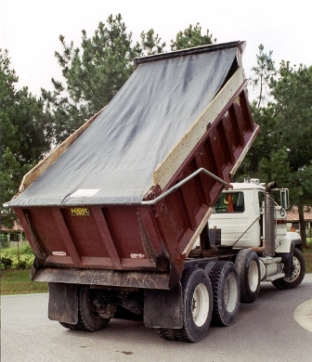
Truck Tarps
Asphalt Summits

Slide 22
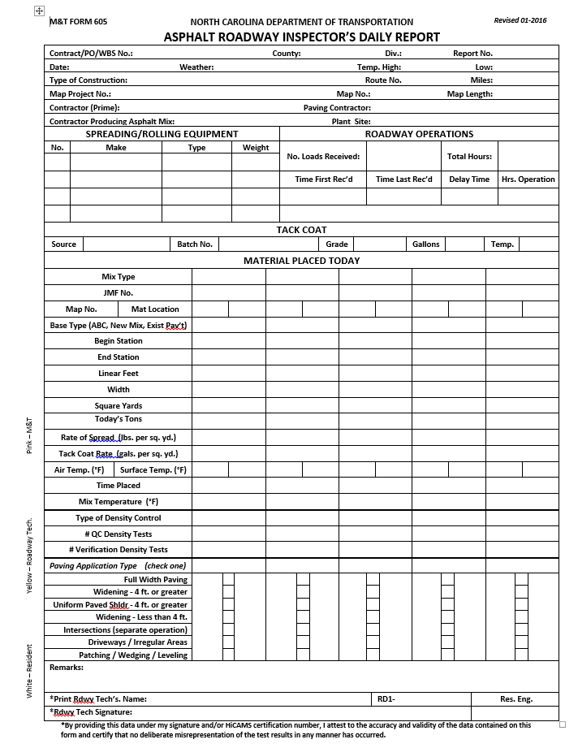
Asphalt Summits
M&T 605 Form
Required:
  This report is to be completed in entirety each day that any pavement is placed on a project.
New SharePoint version

Slide 23
Roadway Density
Asphalt Summits
Situations when Density is REQUIRED:
All full width travel lane pavements, including:
  Normal mainline and -Y- line travel lane pavements
  Turn lanes
  Collector lanes
  Ramps and Loops
  Temporary pavements
Pavement widening 4.0 feet or greater
Uniform width paved shoulders paved in the same operation as the travel lane. Uniform width paved shoulders greater than 4.0 feet paved as a separate operation from the travel lane.

Slide 24
Roadway Density
Asphalt Summits
Situations when Density is NOT Required:
Pavement widening less than 4.0 feet.
Intersections and driveways paved as a separate operation and less than 100 feet.
Paving in irregular areas. Irregular areas are shapes such as tapers or bulb outs that may make them difficult to compact.
Paving for patching, wedging, or leveling.
Complete M&T 605 columns for EACH INDIVIDUAL JMF used.
  Make clear for Auditors WHY No Density Testing was performed.

Slide 25
Small Quantities Cores
Asphalt Summits
For individual structure replacements and projects having 1,500 linear feet or less of roadway pavement.
No Verification or Dispute Resolution cores are required.
A minimum of 2 core samples per pavement layer PER DAY.
SQ cores must be taken in the presence of a DOT technician.
  Should still be an M&T 605 Form with SQ Work.
  Add Comment about “SQ Cores” to M&T 605 & HiCAMS.

Slide 26
Audits
Asphalt Summits
Asphalt Density Query Emails
  From Daniel Walker (dswalker2@ncdot.gov)
  Density Results that have yet to be entered into HiCAMS.
  Corrective Action in response to NCOSA Audit Findings.
Continuing Issues with Density Test Section Lengths
  FY 2016-17 Findings Pending

Slide 27
Investigations
Asphalt Summits
Get Materials & Tests involved as soon as possible.
  Contact Local Pavement Specialist
Available:
  Additional Mix Testing
  Coring
  FWD Testing
  Emulsion Testing
    Sampling Training is REQUIRED

Slide 28
M&T Personnel Updates
Asphalt Summits
Division(s) | Contact Person | Office Location
1 & 2 | Donnie Best | Kinston
3 & 4 | Junior Thornton | Burgaw
5 & 7 | Norm Abrams | McLeansville
6 & 8 | Tom Burrow (acting) | Aberdeen
9 & 10 | Randall Ashmore | Lexington
11 & 12 | Jeff Canter | Wilkesboro
13 & 14 | Dan Hunter | Franklin
Statewide | Jim Sawyer | Raleigh

Slide 29
M&T Personnel Updates
Asphalt Summits
Lab Location | Lab Supervisor
Williamston | Lee Madison
Burgaw | Adam Pearsall
Raleigh | Charles Colgate
Fayetteville | Johnny Hammonds
Lexington | Rebecca Harris
Statesville | Powell Simpson
Asheville | Cathy McAbee
Statewide | David Dunn

