Slide 1
2018 NCDOT Asphalt Summits
Ellis Powell

Slide 2
Upcoming Work Completing on Time
Upcoming work – resurfacing, TIP, preservation – and proposed ad and let dates
Resurfacing and Preservation Let lists – keep up to date
Resurfacing Project Completion data and ideas to improve
Pavement Marking – LD’s, capacity, paint on most NC and SR roads for resurfacing projects, long life marking by other contracts

Slide 3
Completing on Time
Problem resolution
early and often communication
escalation process with timeframes
Importance of good and timely decisions
Completion record – we all share this record
Future funding
Impact on other projects

Slide 4
Working Together
Levels of Experience
Teamwork
Learning from each other
If you don’t know find out – don’t just say no
Use of CEI
Increasing – not going away
Number of CEI inspectors on projects
Keeping up with the cost
Previous NCDOT Experience?

Slide 5
Intent and Flexibility
Holiday Time Restrictions
intent
all holidays the same?
all routes the same?
Lane Closure Time Restrictions
staging vs lane closure
if traffic allows get to work
Working During Seasonal Limitations
Contractors - communicate the desire early
NCDOT - allow if weather permits

Slide 6
General Summit Topics
Patching cost greater than or equal to 10% of estimate – major item – therefore subject to overrun/underrun
Mill & Fill vs Patching and Overlay and Shoulder Work
OGFC Tie-in at Bridges
One mix type going forward – FC-1 Modified
Taper 50’ from the bridge - no milled butt joint
Utility adjustments and rings
Small Quantity Density Acceptance – testing turnaround time
Timely Payment of Monthly Estimate
How to investigate pavement concerns/issues
- Don’t core first, you are making weak spot/pothole – observe, discuss
- Get expert feedback – SPCE, ACE and Pavement Specialists

Slide 7
General Summit Topics
Combining B&C mixes
Decreased rut criteria, increased ESALS
New “B” on more routes
Eliminated 70-22 liquid
One base and one intermediate
Converting mixes - no new control strip
Emulsion Review

Slide 8
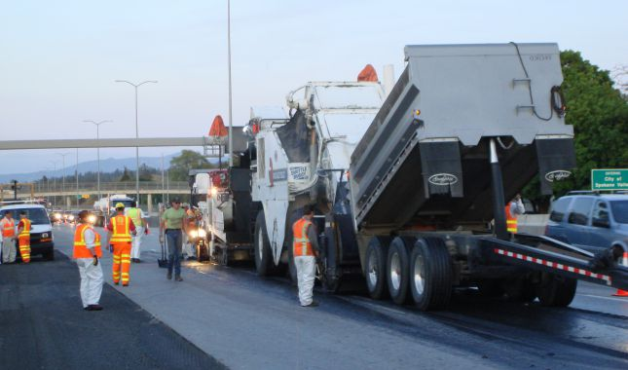
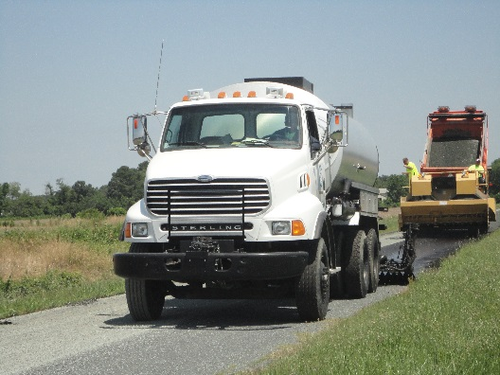
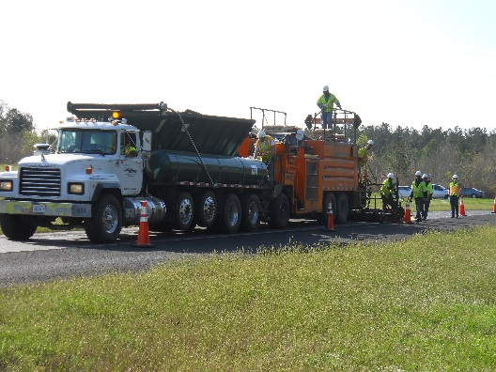
What is an Asphalt Emulsion?
An asphalt emulsion is performance grade asphalt suspended in water using acid and surfactant.
Emulsion is made from varying types of performance grade asphalts.
Emulsion is used in many highway maintenance applications.
Notes:
Surfactant is just a fancy word for soap. Oil and water will not mix without added chemistry and the little bit of acid that is used is to attain the proper ph.
58-28 for CRS-1, 2 and 2L, 64-22 for CQS-1h, 70-22 for non-tracking materials.
Different emulsions are used for tack coats in paving, membranes for chip seals and mixed with screenings for slurry seals and microsurfacing.

Slide 9
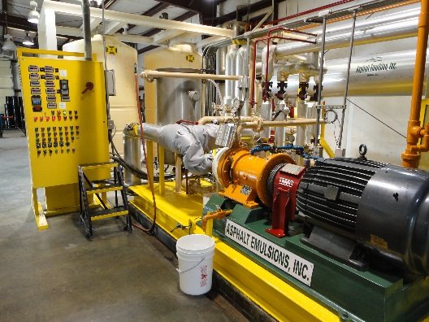
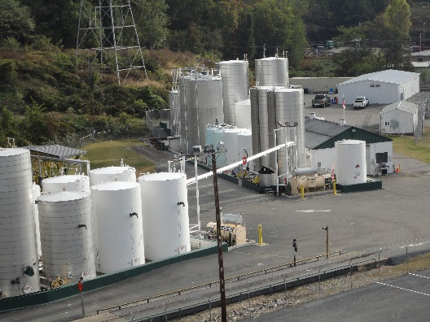
How Is An Emulsion Made?
Asphalt, water, acid and a surfactant are combined using a colloid mill.
All of these ingredients are combined into micron sized particles and the finished product, asphalt emulsion, is then pumped out to storage tanks.
Notes:
So basically what you are doing is suspending the asphalt in water. You do this so you can apply it at lower temperatures. 150f to 180f, depending on the product compared to 320f or higher for PG materials. Safer for people around the operation. Easier to handle than PG materials.

Slide 10
Types of Emulsion
Type Use
CRS-1 Tack Coat
CRS-1H Tack Coat
CRS-2L Chip Seals
HFMS-1 Tack Coat
Notes:
Most emulsions can be used as a tack coat.

Slide 11
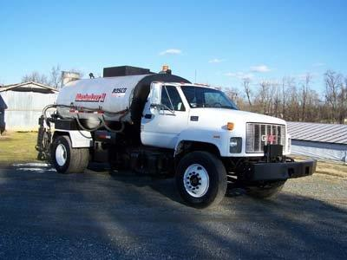
Asphalt Emulsion Storage
How Do You Store Your Emulsion?
Notes:
This is one way to store emulsion. Some folks fill up their 1900 gallon distributor, use 200 or 300 gallons per day, all the while heating and cooling and over pumping the emulsion and at the end of 6,7 or 8 days go back and reload. Also cleaning out with diesel fuel every day which can change the characteristics of the emulsion.

Slide 12
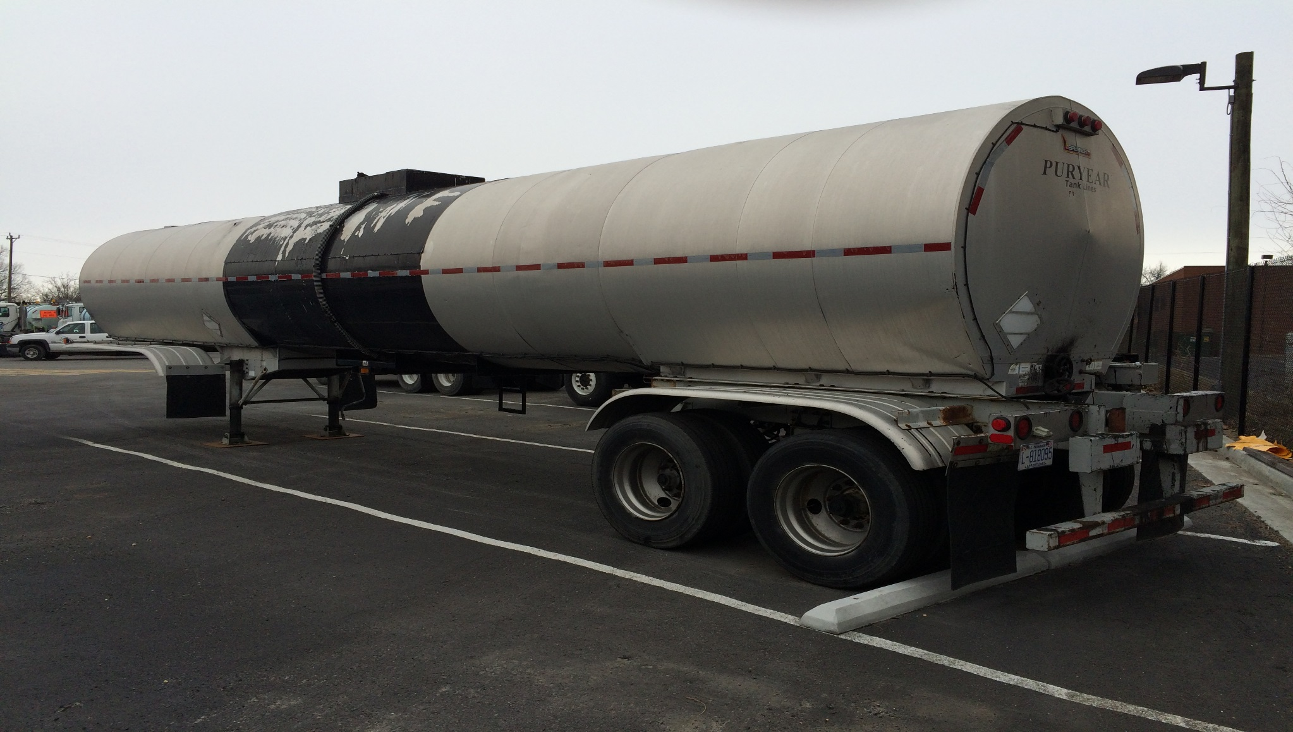
Asphalt Emulsion Storage
How Do You Store Your Emulsion?
Notes:
This is another way some people store their emulsion for tack coat. 5,500 gallon tanker while insulated, is not heated or keeping the product at a constant temperature. This can cause “settling” of the material. By settling I mean the asphalt will fall out of suspension causing clogged nozzles and improper application. This is only good for extremely short periods of time, especially for CRS-1 or CRS-2. Probably not longer than 5 days or so. Some emulsions, for example a CSS-1h or CQS-1h, would last longer than a CRS-1 or 2 stored this way since they are stored at lower temperatures and have more chemistry in them. Still they should only be stored like this in the summer months and again, no longer than 5 days or so.

Slide 13
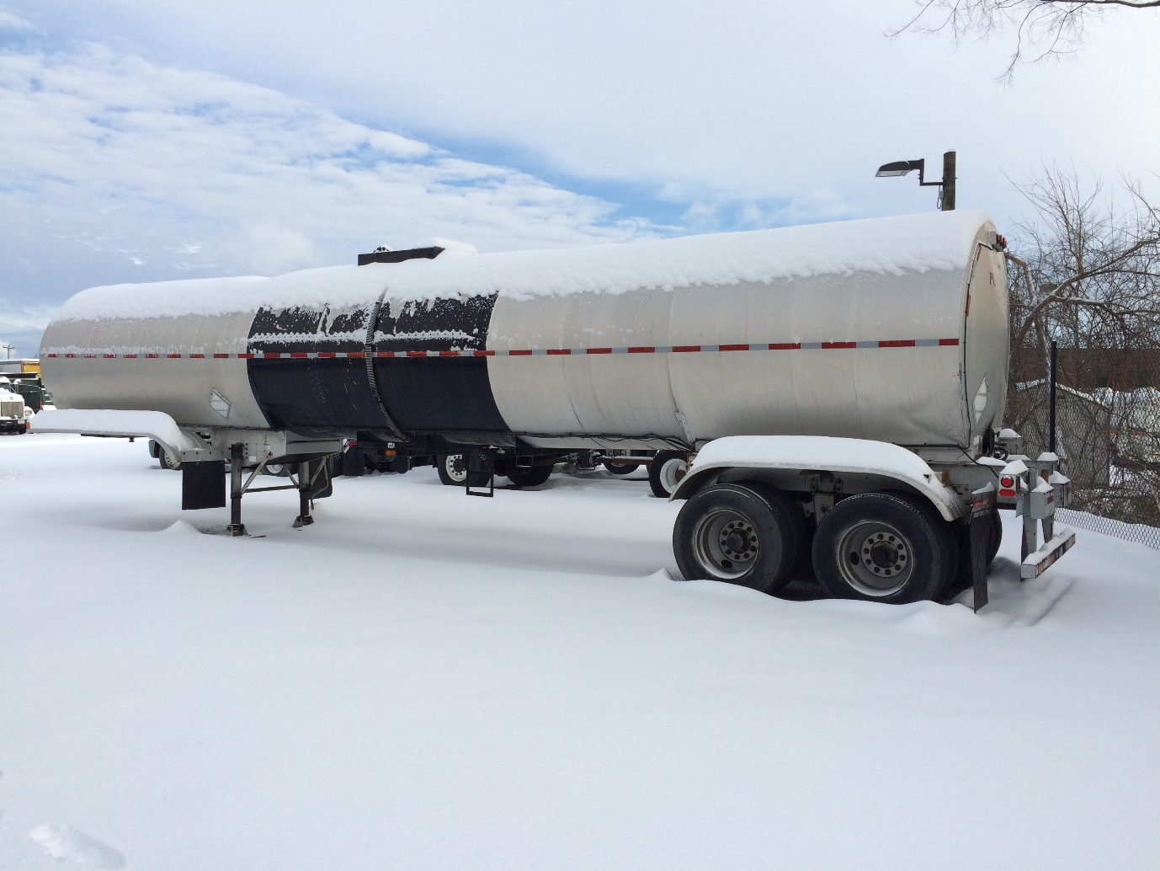
Asphalt Emulsion Storage
How Do You Store Your Emulsion?
Notes:
In cold weather this is definitely NOT the way to do it.

Slide 14
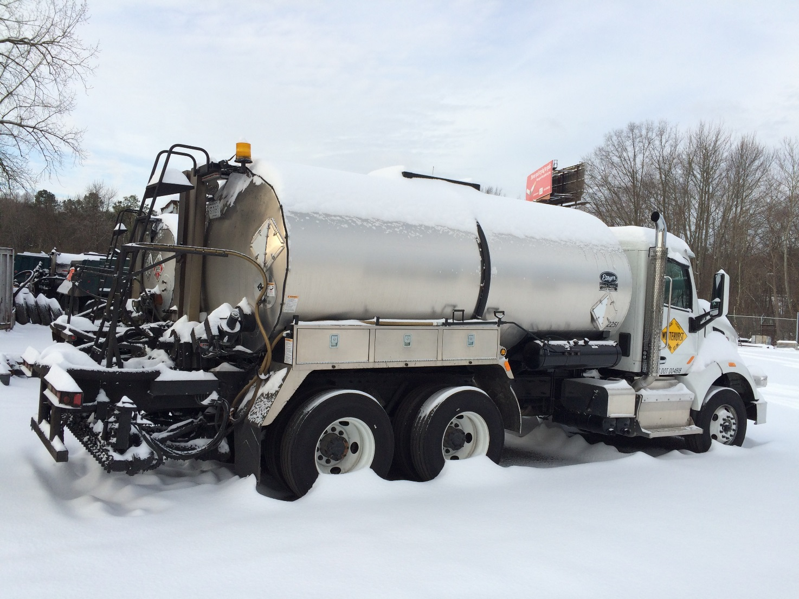
Asphalt Emulsion Storage
How Do You Store Your Emulsion?
Notes:
This isn’t a good way either. Even though they can be heated it will not be the constant heat that is needed.

Slide 15
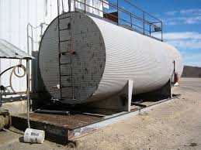
Asphalt Emulsion Storage
How Do You Store Your Emulsion?
Notes:
While better than a tanker or distributor if it is heated, this horizontal tank is not the best of options for long term storage. By long term I mean 3 weeks or more. More of the surface area of the product is exposed to the air and if the tank is heated it will allow for more evaporation of water from the product than a vertical tank. The more surface that is exposed to air also allows for the emulsion to start breaking and creating shot.

Slide 16
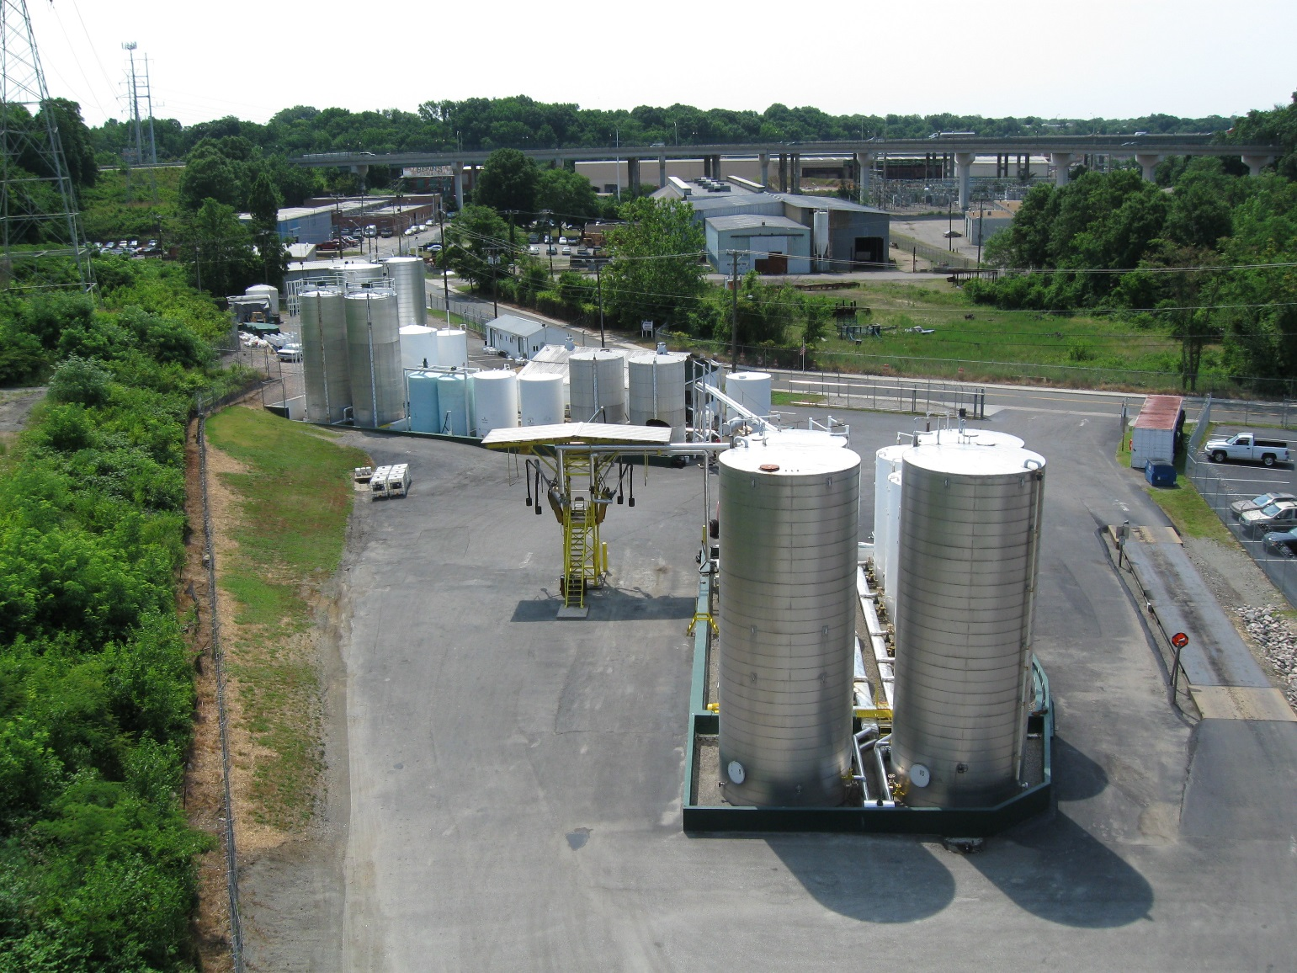
Asphalt Emulsion Storage
How Do You Store Your Emulsion?
Notes:
This is the preferred way to store emulsion long term. Insulated and heated vertical tanks kept a constant temperature.

Slide 17
Handling Emulsion
Do Not Heat And Cool Repeatedly.
Repeated heating and cooling can cause the material to fall out of suspension making the tack useless.
If you need 500 gallons to cover the flue for heating then only load 500 gallons.
Load the distributor with the day’s production in mind and reduce pumping left over material back into the holding tank.
Do Not Constantly Pump.
Repeated pumping will cause the emulsion to shear which creates small particles that will clog the nozzles.
Notes:
Okay, we’ve talked about storing emulsions so let’s move on to handling them.

Slide 18
Handling Emulsion
Do Not Allow Emulsion to Freeze In The Tank
When an emulsion freezes the asphalt and water separate causing the material to break in the tank.
Use Diesel Fuel Properly For Pump Cleanout
Be sure to use the Reclaimation Tank on the Distributor and remove all fuel prior to pumping into distributor
Diesel fuel introduced into the distributor will change the characteristics of the emulsion.

Slide 19
Handling Emulsion
Do Not Add Water
Unless you are using an emulsion for prime on an aggregate base, applying a cure seal to CTA or fogsealing a shoulder or rumble strip you should never add water to an emulsion..
By adding water to an emulsion that is used for tack you lower your residual asphalt content which can lead to bonding issues.

Slide 20
Contamination and Sampling
Emulsions are chemical systems, they should never be mixed with other types of emulsions, they should never be mixed with other chemicals. Never mix emulsions from different producers.
For emulsions cleanliness is very important. A sloppy operation will produce problems. When an emulsion comes in contact with air it can begin to break.
Distributors and tankers should be clean and flushed between loads. New material should not be pumped in on top of old material, especially different grades. Diesel fuel is a common contaminant that is known to destabilize an emulsion.
Emulsion Sampling – Follow AASHTO R66, Before sampling contact M&T to be sure proper protocol is followed. Results indicating a failing sample may be false if protocol not followed; needlessly causing frustration, confusion and wasted time.

Slide 21
Pave After Emulsion Breaks
Allow Time For Emulsion To Break Prior To Paving
The length of time depends upon environmental factors and application rate
When it is hot outside emulsion breaks quicker (few minutes)
When it is windy emulsion breaks quicker (few minutes)
When it’s cold outside emulsion breaks slower (several minutes)
When there is more moisture in the air emulsion breaks slower (several minutes)
Higher application rate- emulsion takes longer to break
When emulsion breaks it changes color from brown to black (as the water evaporates)
Paving before emulsion breaks can lead to bonding issues

Slide 22
Questions and Comments?

