Slide 1
CAPA 66th Annual Meeting – April 22, 2014

Slide 2
Fiscal Update
Staffing
Funding
Lettings

Slide 3
NCDOT LCCA/Alternate Pavement Bidding Update

Slide 4
RAP/RAS Monitoring
Issues with RAP / RAS mixes
CAPA / DOT discussions
Cold weather paving was an issue
DOT develops a RAP/RAS minor specification changes and monitoring program

Slide 5
RAP/RAS Spec and Process Changes
Final surface mixes with RAS are subject to 50 degree paving requirement.
Apply spec criteria: Do not use combined % of RAS and RAP greater than 20% (unless otherwise approved) using below JMF approval criteria:
    Surface mixes of RAS or combo, max contributed RAS binder is 20% and max contributed binder for RAS + RAP is 40%
    Intermediate & Base mixes of RAS or combo, max contributed binder is 23% and max contributed binder for RAS + RAP is 45%

Slide 6
RAP/RAS Monitoring Plan
Monitor mixes with Contributed Binder greater than 30% from recycled products
Conduct on current JMFs since January 2011
Monitoring 23 projects with 11 specific JMFs
Began in Fall 2014 and will go back every 6 mos.

Slide 7
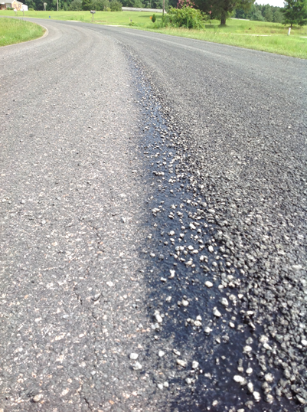
Outsourcing AST
Legislation passed in Fall 2014
Pavement Preservation Fund = $65 million
Outsource Pavement Preservation to Industry
Many eligible activities (Focus on chip seal work)
DOT and CAPA Partnership
  Specification / Contract Development
  Training
DOT requirements
  Data tracking

Slide 8
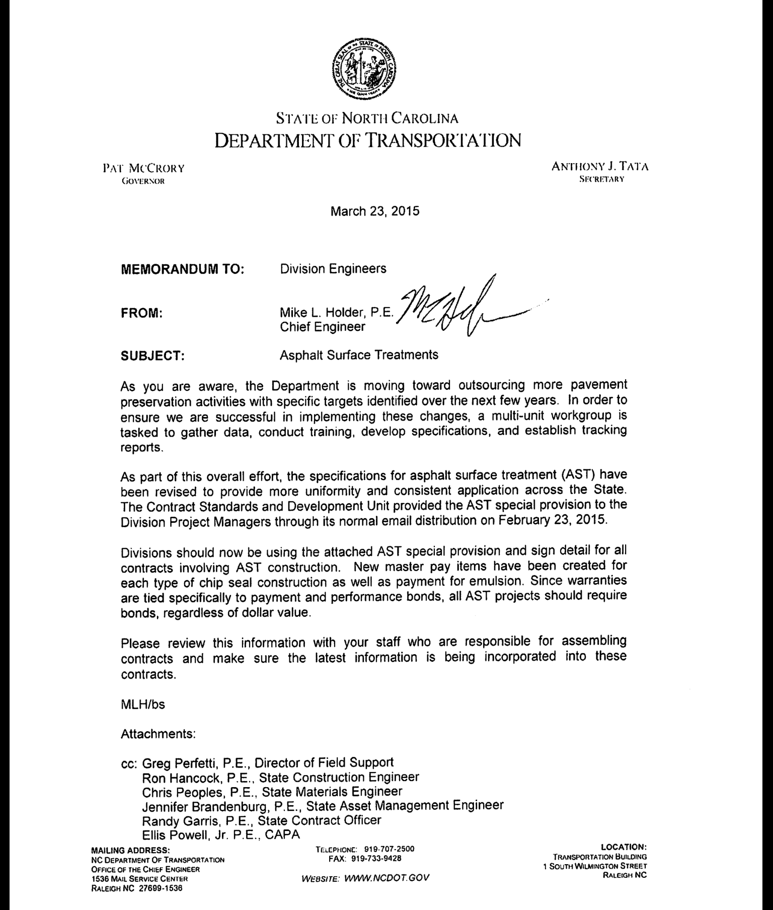
Revised AST Specification

Slide 9
Outsourcing AST - Timeline
Goals
  Outsource 30% in FY 2015
  Outsource 55% in FY 2016
  Outsource 80% in FY 2017
DOT / CAPA Spec meetings in late 2014
AST breakout at CAPA Workshop – Feb. 23-24, 2015
NCPP Chip Seal Training – Feb. 25, 2015
New spec in contracts – March 2015
Chip Seal Best Practices Manual – Under development
Three regional AST training sessions – Mid/Late 2015

Slide 10
Prequalification
To update list of AST firms, Contractual Services sent out notices to all current AST firms and asphalt contractors to re-apply for AST work
AST work code is 660
To date, 72 firms have been pre-qualified for 660
New work code 659 was created for Microsurfacing & Slurry Seal work
To date, 13 firms have been pre-qualified for 659

Slide 11
REOB Update
Continue to monitor/test for presence in asphalt binder
Monitor areas where material containing REOB have been placed
Treat hits case by case
Long term – waiting to see recommendations of AASHTO Task Force

Slide 12
Materials Suppliers Interactive Maps
http://ncdot.maps.arcgis.com/home/webmap/viewer.html?layers=3cdb5622ba83469dac31835099f98478

Slide 13
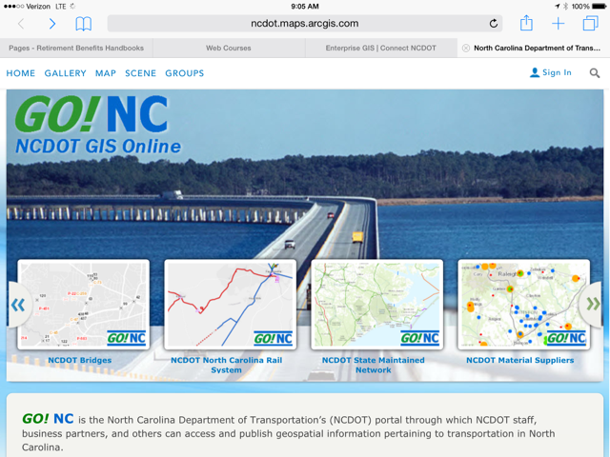

Slide 14
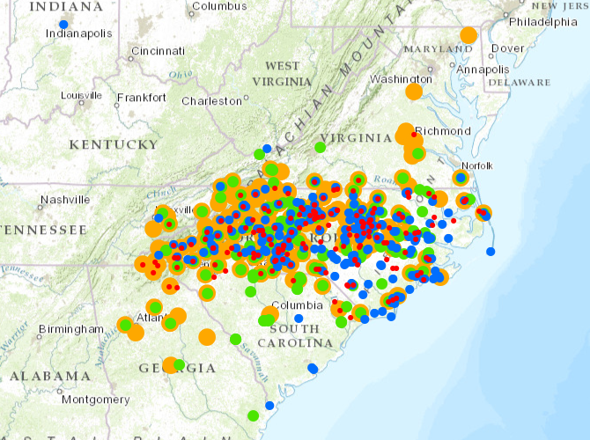
Materials Suppliers (All)

Slide 15
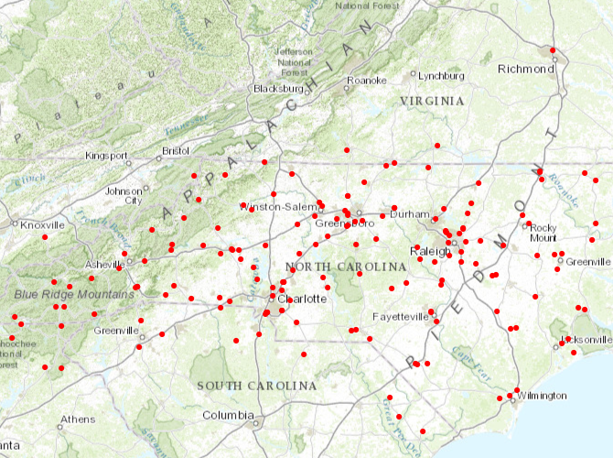

Slide 16
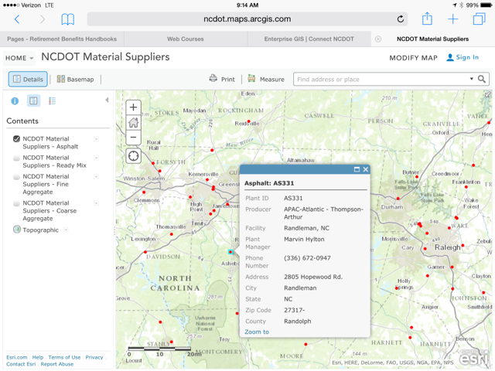

Slide 17
What is CUF?
CUF: Commercially Useful Function
49 CFR 26 defines a ‘commercially useful function’ (CUF) as when a DBE actually performs, manages, and supervises the work under their subcontract.

Slide 18
CUF Checklist
DBE firm is committed for the work and has an approved subcontract
DBE firm is responsible for a distinct element of the work
DBE firm manages its own forces and performs its own work
DBE firm provides its own materials and equipment
Prime does not perform any part of the work on behalf of the DBE firm

Slide 19
Counting Participation
  Subcontracts (2nd Tier)
    DBE – Eligible
    Non-DBE – Not Eligible
  Material Suppliers and Manufacturers
    DBE Suppliers – 60%
    DBE Manufacturers – 100%

Slide 20
Joint Checks
Two party check payable to subcontractor and material supplier
Special Provisions require prior notification when claiming DBE participation credit
Process initiated by subcontractor not prime
Subcontractor Responsibilities:
  negotiate price, determine quantities, order, install, pay
Form should be submitted to RE with Subcontract Approval Form (SAF)

Slide 21
Joint Checks
Contractor must send joint check to subcontractor not supplier
Subcontractor pays supplier
Additional documentation sent to RE
  Copy of joint check
  Copy of material quote from supplier to subcontractor

Slide 23
Replacement Rules
  Acceptable reasons
    Performance
    Decertification
  Prime must have adequate documentation of performance related issues
  Can use additional (non-committed) DBEs submitted at bid time
  Good Faith Effort if no additional DBEs
  Replacement Form submitted to RE

Slide 24
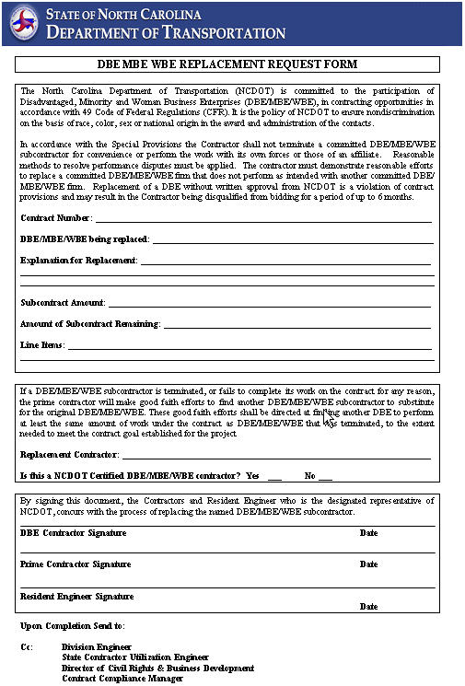
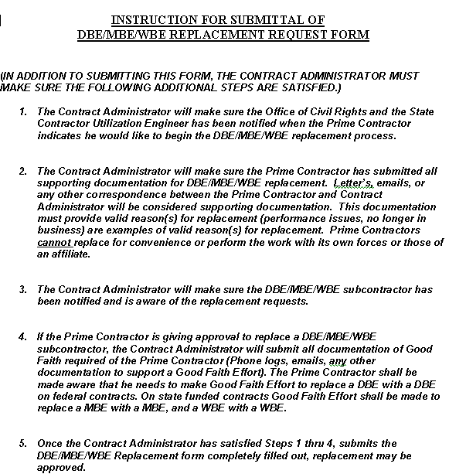
DBE Replacement Form

Slide 25
Trucking
49 CFR 26.55(d)(2)
  The DBE must itself own and operate at least one fully licensed, insured, and operational truck used on the contract.

Slide 26
Trucking
On-project Hauling
Plant Hauling
Trucking Plan
50/50 Rule

Slide 27
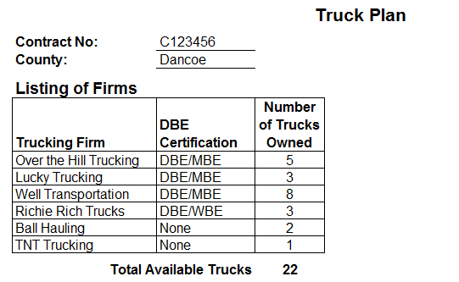
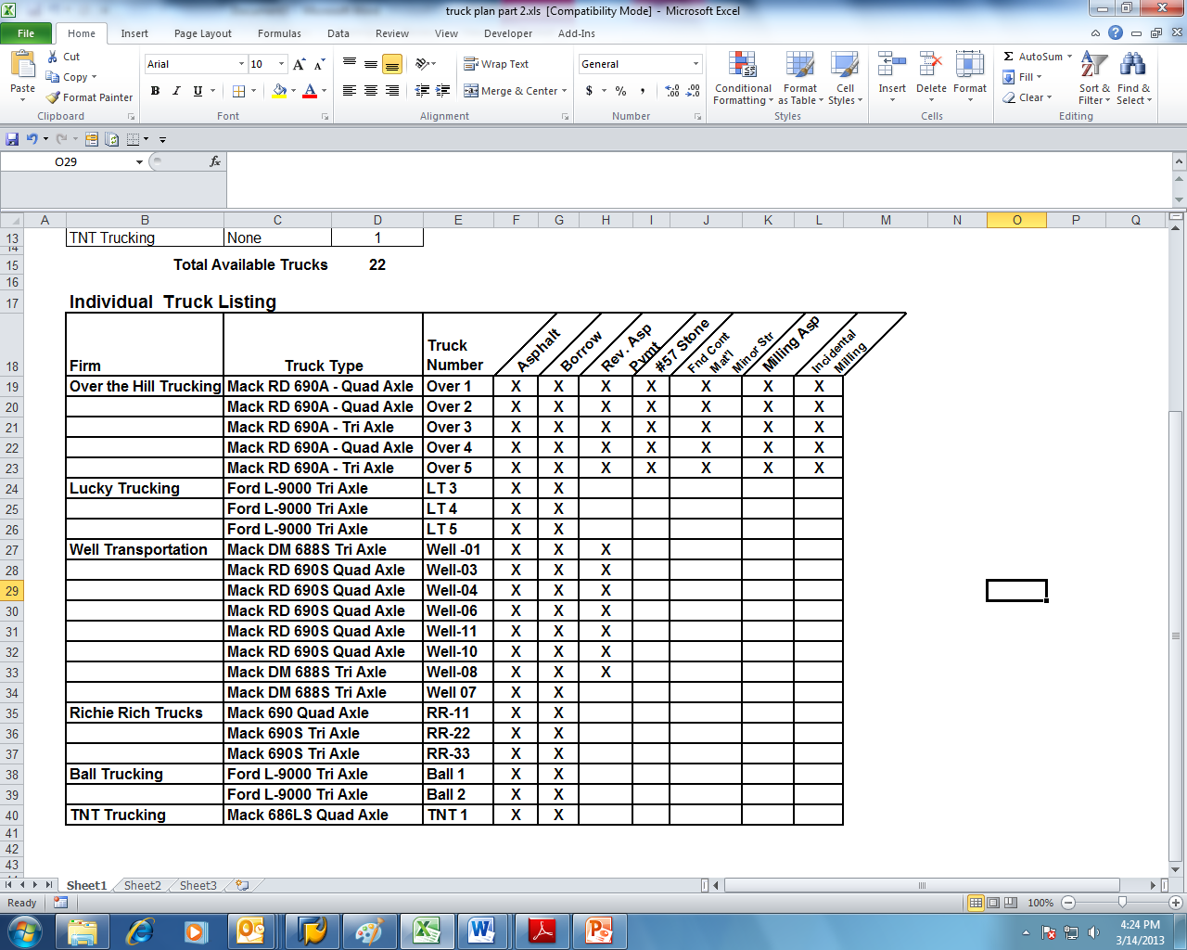

Slide 28
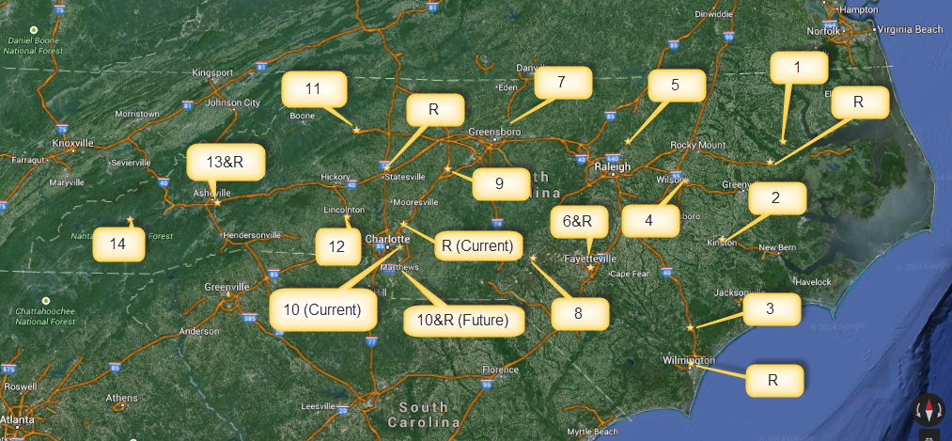

Slide 29
811 Utility Location Issues

